Slide 1
Multithreading & Concurrency
with Java examples
CHOI Hong Joon

Slide 2
Single-tasking -> Multi-processing -> Multi-threading

Slide 3
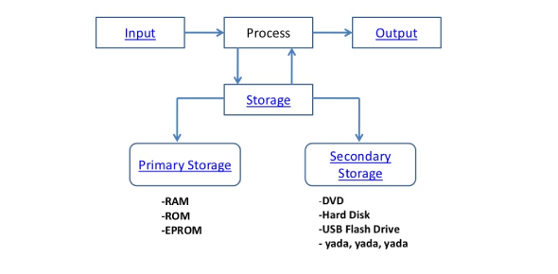
Computer Architecture
Keyboard
Mouse
Network I/O
…
Monitor
Speaker
Network I/O
…
메모리
저장장치/스토리지
(DB도 포함)

Slide 4
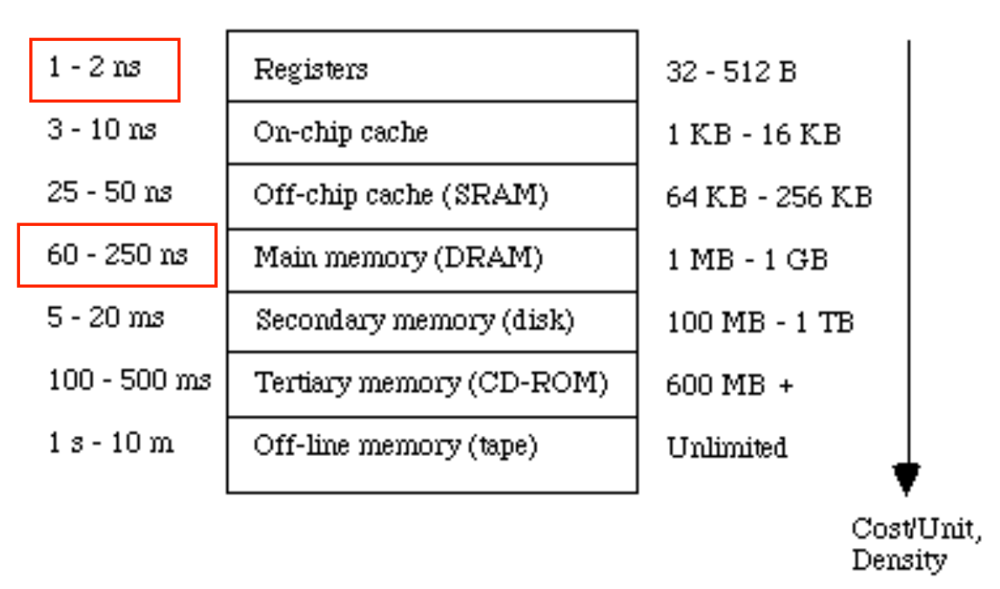
Latency numbers every programmers should know
https://gist.github.com/jboner/2841832
Memory access: ~x100 times slower than register access
Disk access: ~x100,000 times slower than memory access
1000 nano = 1 micro | 1000 micro = 1 millis | 1000 millis = 1

Slide 5
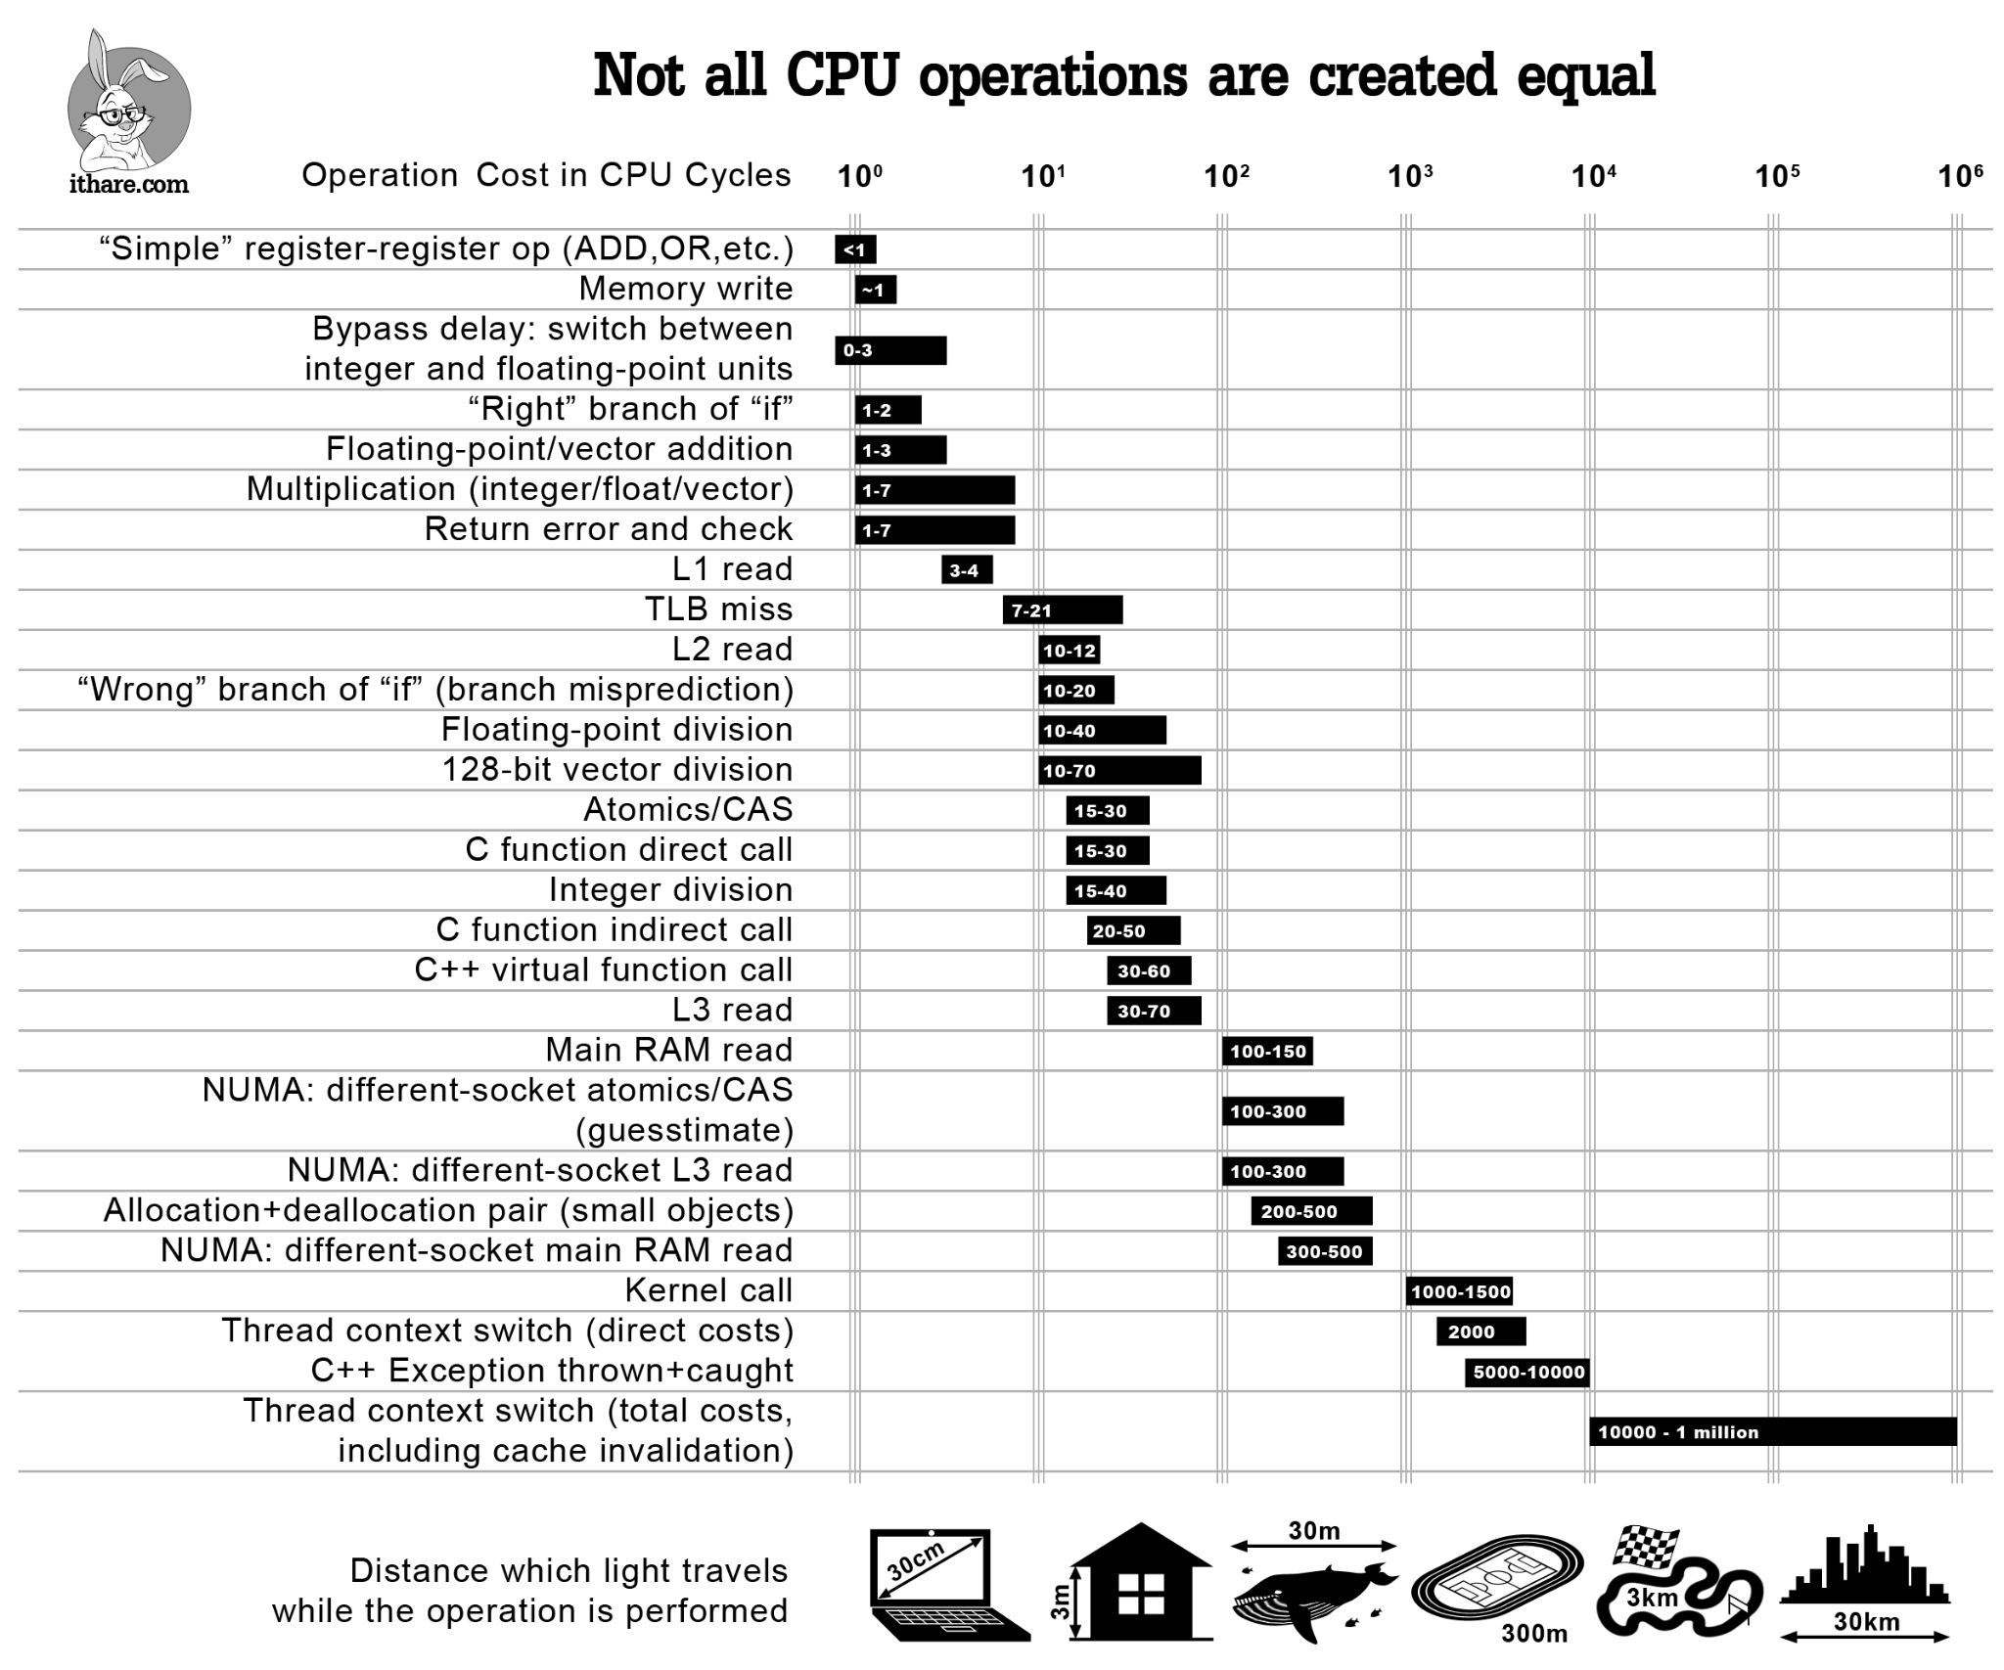
Latency numbers (continued)
1GHz CPU
clock cycle time = 1ns,
addition: 1~3 cycles
division: 15~40 cycles

Slide 6
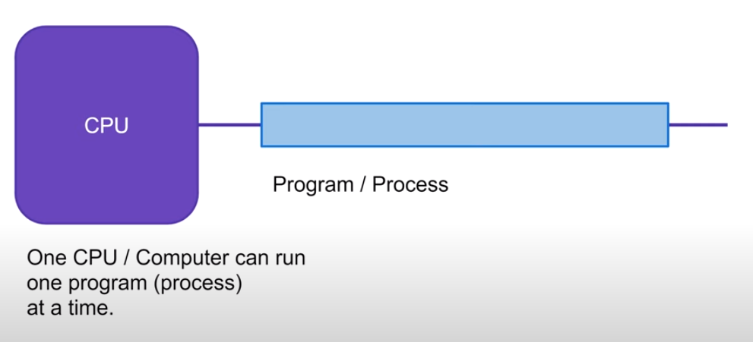
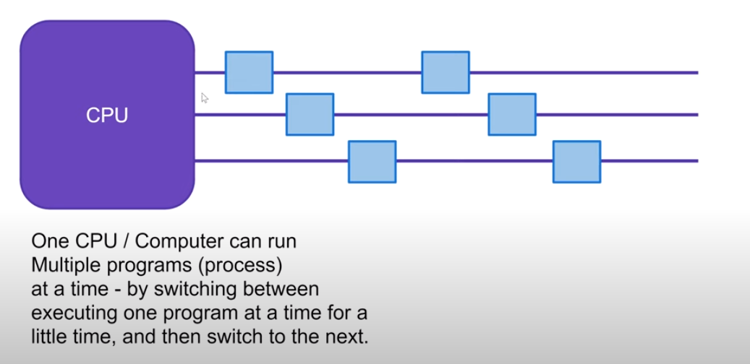



Single tasking -> Multi tasking
Single tasking in
early days of computing
Program 1
time
영상 디코딩
영상 디코딩
Multitasking
게임 로직 계산
프레임 갱신
time

Slide 7
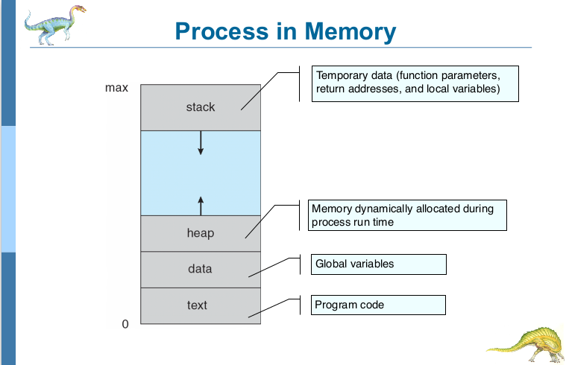
프로세스 메모리 구조

Slide 8
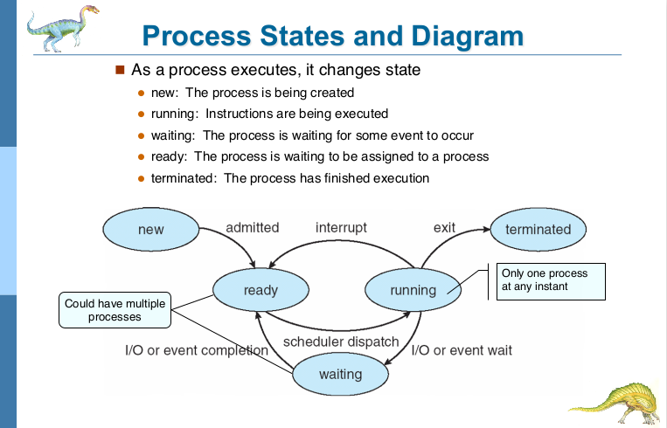
프로세스 lifecycle
(Optional)

Slide 9
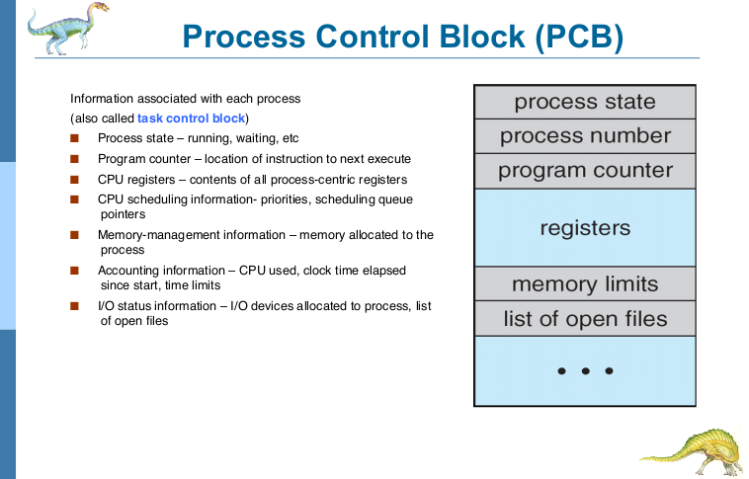
Optional
프로세스가 어떤 상태로 수행되고 있는지를 Context라고 부름.

Slide 10
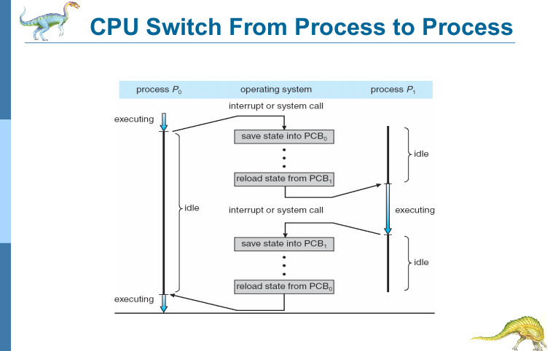
Context Switching
=>Time wasted!!
=>Time wasted!!
time
프로세스에서 다른 프로세스로 CPU 제어권을 넘겨줄 때 (Context Switching), Cache 메모리를 초기화 시킴과 동시에 PCB 정보를 레지스터에 다시 불러와야 함.
잦은 Context Switching (0.001~1ms 소요)은 성능 저하를 불러옴.
https://dding9code.tistory.com/92
https://junghyungil.tistory.com/105#:~:text=%EB%AC%B8%EB%A7%A5%EA%B5%90%ED%99%98(Context%20Switching)%EC%9D%98,1%20~%201000%20%EB%A7%88%EC%9D%B4%ED%81%AC%EB%A1%9C%20%EC%B4%88(micro

Slide 11
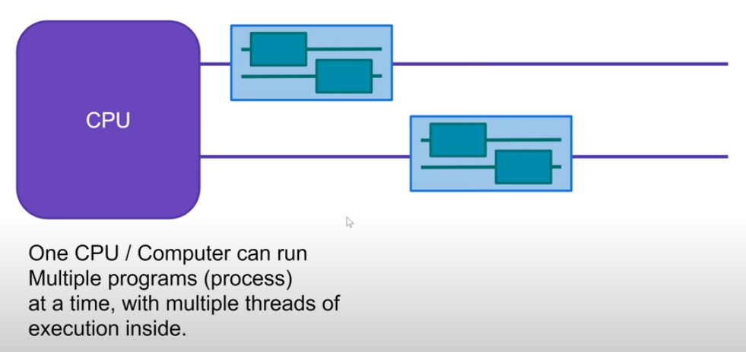
Multi processing -> Multi threading
https://sachidisanayaka98.medium.com/how-chrome-browser-use-process-threads-643dff8ad32c
Thread 1: main UI
Thread 2: handle network I/O
Thread 1:
그래픽 관련 연산
Thread 2:
캐릭터 길찾기 알고리즘 수행

Slide 12
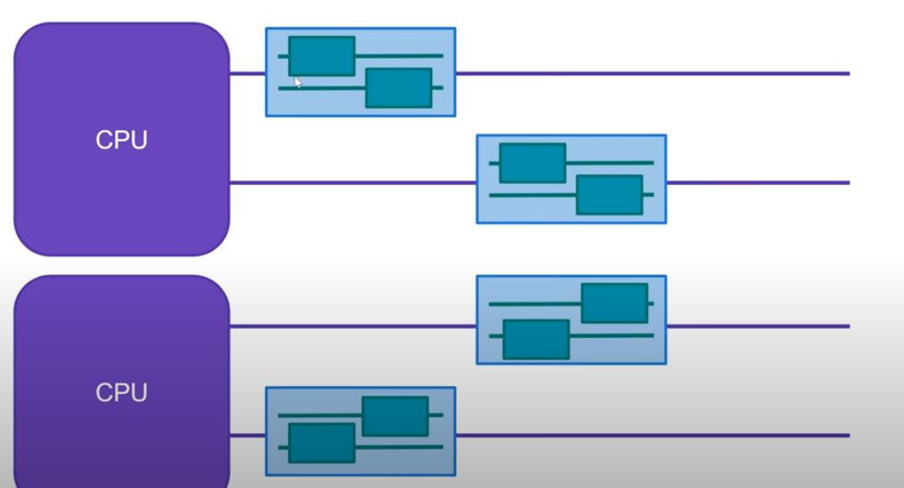
Concurrency -> Parallelism
Parallelism always implies concurrency, but not the other way around.
병렬성은 언제나 동시성을 의미함.
하지만, 동시성이 병렬을 의미하지 않음.

Slide 13
Example 1: calculate mean with multiple threads (1/2)
import java.util.Random;
public class ComputationWithThreadFullEx {
final static int THREADS_COUNT = 1;
public static int add_with_heavy_computation(int a, int b) {
Random rand = new Random();
for (int i = 0; i<200000; ++i) {
int rand_int = rand.nextInt(100);
}
return a + b;
}
public static class MyThread extends Thread {
private final int[] scores;
private final int start;
private final int end;
private int sum;
public MyThread(int[] scores, int start, int end) {
this.scores = scores;
this.start = start;
this.end = end;
this.sum = 0;
}
public int getSum() {
return this.sum;
}
@Override
public void run() {
System.out.println("Thread " + Thread.currentThread().getId() + ": start, end index = " + start + ", " + end);
for (int i = start; i< end; ++i) {
sum = add_with_heavy_computation(sum, scores[i]);
}
}
}

Slide 14
Example 1: calculate mean with multiple threads (2/2)
public static void main(String[] args) {
int[] scores = new int[1000];
MyThread[] threads = new MyThread[THREADS_COUNT];
long startTime = System.currentTimeMillis();
// initialize scores
for (int i = 0; i < scores.length; ++i) {
scores[i] = i;
}
// initialize and start threads
for (int i =0; i<THREADS_COUNT; ++i) {
threads[i] = new MyThread(scores, i*scores.length/THREADS_COUNT, (i+1)*scores.length/THREADS_COUNT);
threads[i].start();
}
// join all threads
try {
for (int i =0; i<THREADS_COUNT; ++i) {
threads[i].join();
}
} catch (InterruptedException e) {
throw new RuntimeException(e);
}
// sum up all partial means and compute aggregate mean.
int sum = 0;
System.out.println();
for (int i = 0; i<THREADS_COUNT; ++i) {
System.out.println("partial sum of thread " + threads[i].getId() + " = " + threads[i].getSum());
sum += threads[i].getSum();
}
System.out.println("\nMean score = " + ((float)sum / (float)scores.length));
long endTime = System.currentTimeMillis();
System.out.printf("%d milliseconds elapsed.\n", (endTime-startTime));
}
}

Slide 15
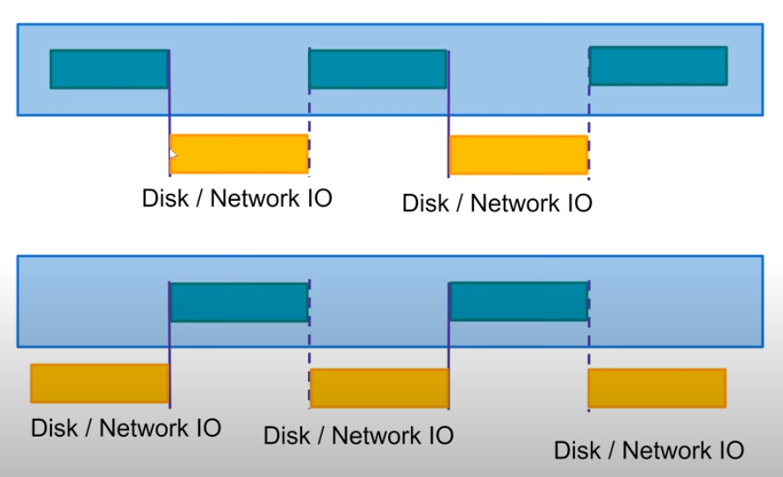
Why Multithreading?
Better I/O utilization
Better CPU utilization

Slide 16
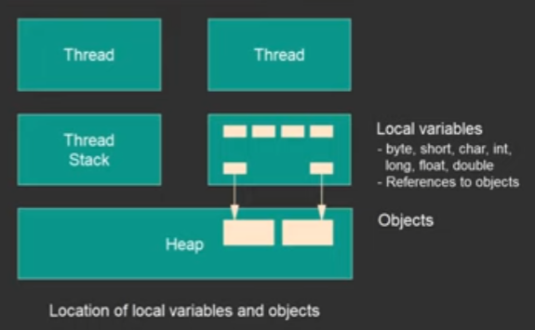
Threads memory structure

Slide 17
2. Multithreading issues

Slide 18
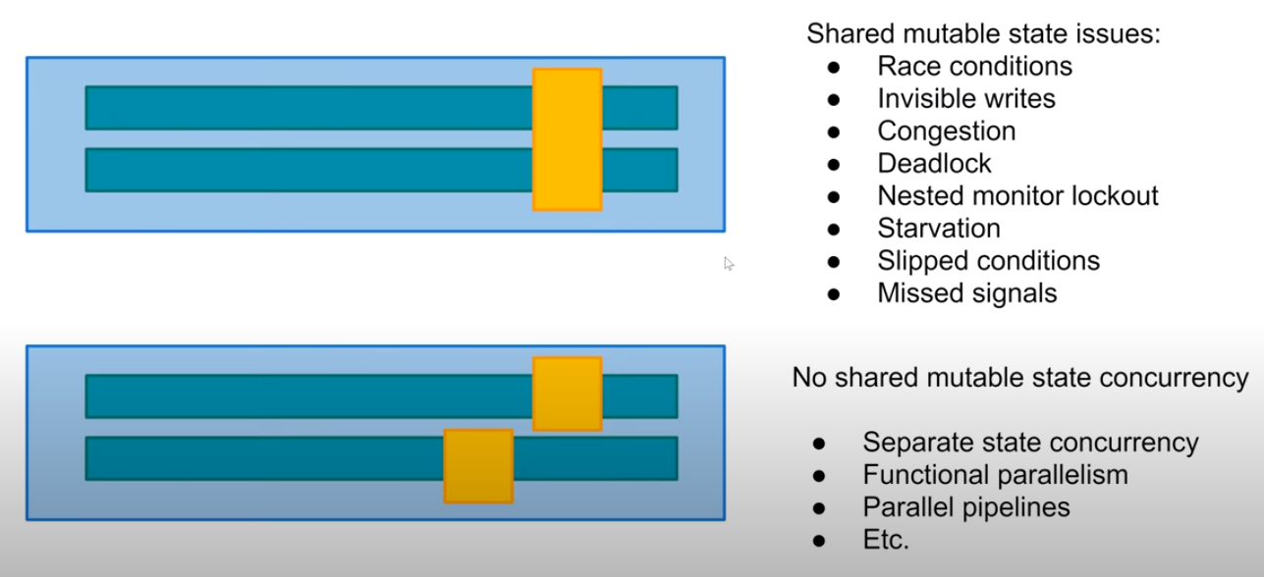
Multithreading Issues 1: Race condition

Slide 19
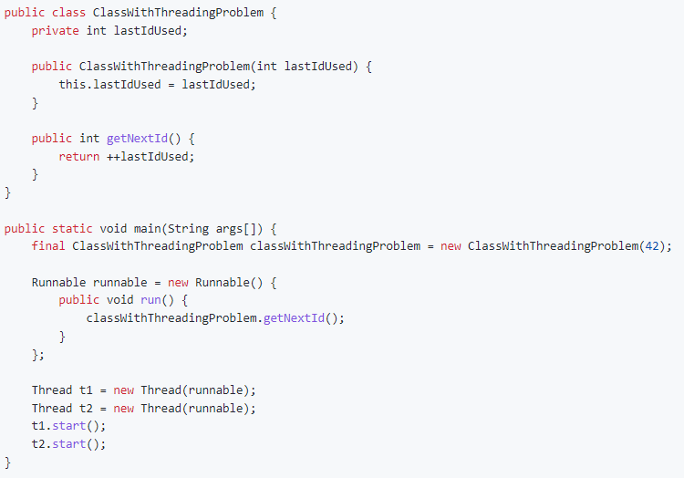

Example 2.1: race condition

Slide 20
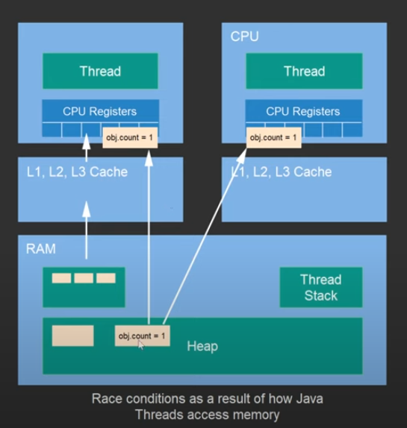
Example 2.1: race condition (memory illustration)

Slide 21
Types of race condition
Read-modify-write
Check-then-act

Slide 22
Solution 1: synchronized
import java.util.Random;
public class RaceCondition {
public static class Counter {
private int cnt;
public Counter() {
this.cnt = 0;
}
public synchronized int getNextCounter() {
this.cnt = this.cnt + 1;
return this.cnt;
}
}
public static class MyThread extends Thread {
private Counter counter;
public MyThread(Counter counter) {
this.counter = counter;
}
@Override
public void run() {
for (int i = 0; i < 10000; ++i) {
counter.getNextCounter();
}
}
}
public static void main(String[] args) {
Counter counter = new Counter();
MyThread thread1 = new MyThread(counter);
MyThread thread2 = new MyThread(counter);
MyThread thread3 = new MyThread(counter);
thread1.start();
thread2.start();
thread3.start();
try {
Thread.sleep(50);
} catch (InterruptedException e) {
throw new RuntimeException(e);
}
System.out.println(counter.getNextCounter());
}
}

Slide 23
Volatile variable
Volatile variables are guaranteed to be flushed into main memory (instead of being cached at times) to prevent data visibility problem in multi-threaded applications

Slide 24
Happens before guarantee
CPU doesn’t automatically reorder instructions inside
synchronized block
Instructions before modifying any volatile variable

Slide 25
References
2015 HKUST COMP2611 Computer Organization
2015 HKUST COMP3511 Operating Systems (공룡책)
https://gist.github.com/jboner/2841832
http://ithare.com/infographics-operation-costs-in-cpu-clock-cycles/
https://www.crocus.co.kr/1366 프로세스, 메모리 구조
https://gmlwjd9405.github.io/2018/09/14/process-vs-thread.html 프로세스와 스레드 차이
https://www.youtube.com/watch?v=mTGdtC9f4EU&list=PLL8woMHwr36EDxjUoCzboZjedsnhLP1j4&index=1&ab_channel=JakobJenkov Java Concurrency and Multithreading
https://github.com/Yooii-Studios/Clean-Code/blob/master/Chapter%2013%20-%20%EB%8F%99%EC%8B%9C%EC%84%B1.md
https://nesoy.github.io/articles/2018-06/Java-volatile Java volatile 키워드 (캐시메모리 사용하지 않게끔 하는 키워드)
https://enumclass.tistory.com/169#toc-%EC%95%8C%EA%B3%A0%EC%9E%90%20%ED%95%98%EB%8A%94%20%EA%B2%83%20:%20Synchronized%C2%A0keyword,%20ReentrantLock,%20Semaphore,%20Atomic,%20varHandle Java 동기화 및 Lock

